Slide 1


Slide 2

13
MONOPOLISTICCOMPETITION

Slide 3
After studying this chapter you will be able to
Define and identify monopolistic competition
Explain how a firm in monopolistic competition determines its price and output in the short run and the long run
Explain why advertising costs are high and why firms use brand names in monopolistic competition
Copyright © 2013 Pearson Canada Inc., Toronto, Ontario

Slide 4
The online shoe store shoebuy.com lists athletic shoes made by 56 different producers in 40 different categories and price between $25 and $850.
It offers 1,404 different types for women and 1,757 different types for men.
Athletic shoe producers compete, but each has a monopoly on its own special kind of shoe.
With so many different types of athletic shoes, the market isn’t perfectly competitive.
The model of monopolistic competition helps us to understand the competition that we see in the markets for athletic shoes and most other goods and services we buy.
Copyright © 2013 Pearson Canada Inc., Toronto, Ontario

Slide 5
What Is Monopolistic Competition?
  Monopolistic competition is a market structure in which
  A large number of firms compete.
  Each firm produces a differentiated product.
  Firms compete on product quality, price, and marketing.
  Firms are free to enter and exit the industry.

Slide 6
Monopolistic Competition
Large Number of Firms
  The presence of a large number of firms in the market implies:
  Each firm has only a small market share and therefore has limited market power to influence the price of its product.
  Each firm is sensitive to the average market price, but no firm pays attention to the actions of others. So no one firm’s actions directly affect the actions of others.
  Collusion, or conspiring to fix prices, is impossible.

Slide 7
What Is Monopolistic Competition?
Product Differentiation
  A firm in monopolistic competition practices product differentiation if the firm makes a product that is slightly different from the products of competing firms.

Slide 8
What Is Monopolistic Competition?
Competing on Quality, Price, and Marketing
  Product differentiation enables firms to compete in three areas: quality, price, and marketing.
  Quality includes design (look/ease of use), reliability (how well/long does it work), and service (how quick/efficient is customer support).
  Because firms produce differentiated products, the demand for each firm’s product is downward sloping. But there is a tradeoff between price and quality (you generally ‘give up’ more money to get better quality).
  Because products are differentiated, a firm must market its product. Marketing takes two main forms: advertising and packaging.
Copyright © 2013 Pearson Canada Inc., Toronto, Ontario

Slide 9
Monopolistic Competition
Entry and Exit
  There are no barriers to entry in monopolistic competition, so firms cannot make an economic profit in the long run.
Examples of Monopolistic Competition
  Producers of audio and video equipment, clothing, jewelry, computers, and sporting goods operate in monopolistic competition.

Slide 10
Price and Output in Monopolistic Competition
The Firm’s Short-Run Output and Price Decision
  A firm that has decided the quality of its product and its marketing program produces the profit-maximizing quantity (the quantity at which MR = MC).
  Price is determined from the demand for the firm’s product and is the highest price that the firm can charge for the profit-maximizing quantity.
  Figure 14.1 shows a firm’s economic profit in the short run.

Slide 11
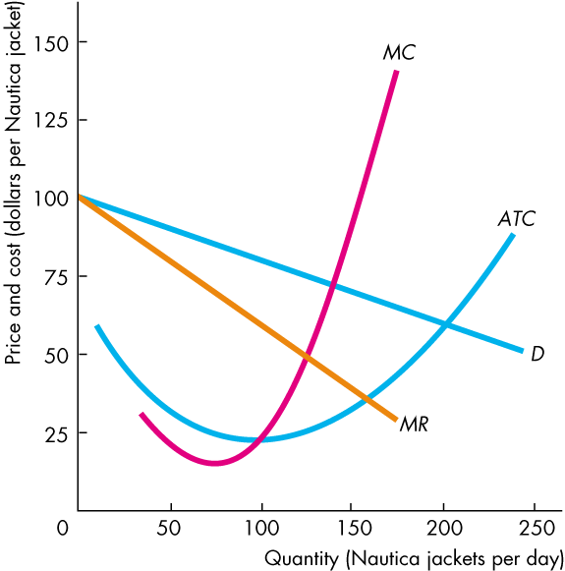
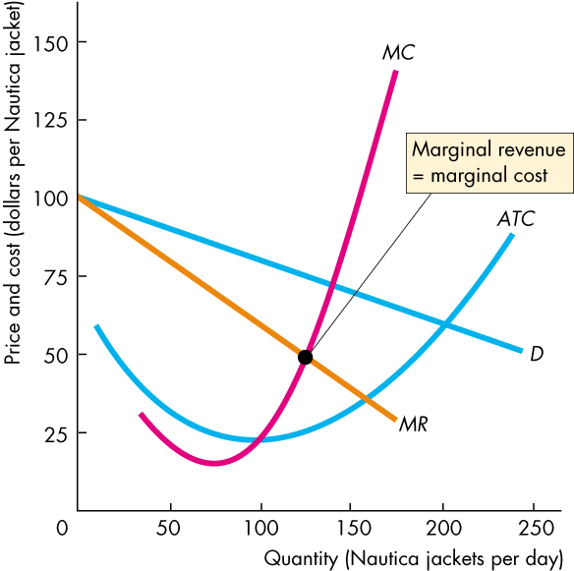
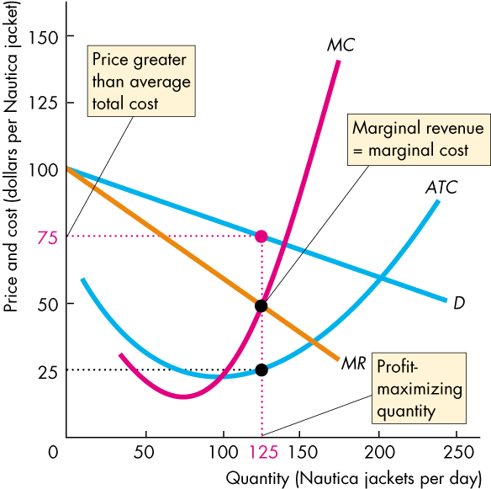
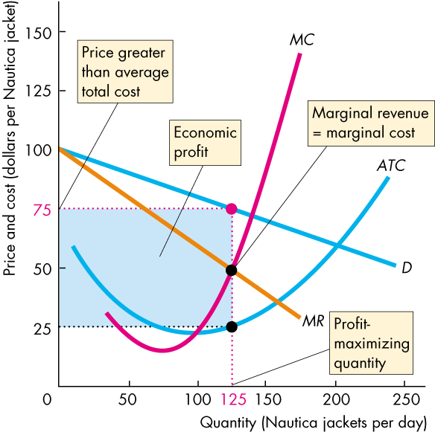
Price and Output in Monopolistic Competition
  The firm in monopolistic competition operates like
  a single-price monopoly.
  The firm produces the quantity at which MR equals MC and sells that quantity for the highest possible price.
  It makes an economic profit (as in this example) when P > ATC.

Slide 12
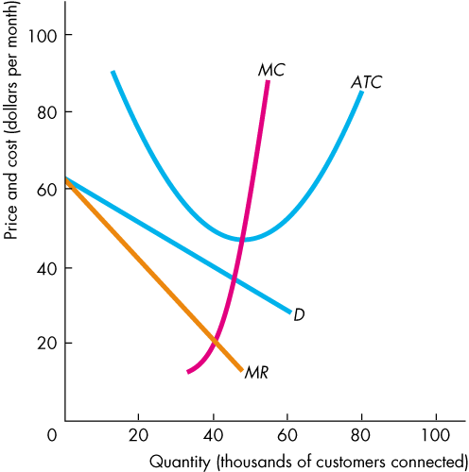
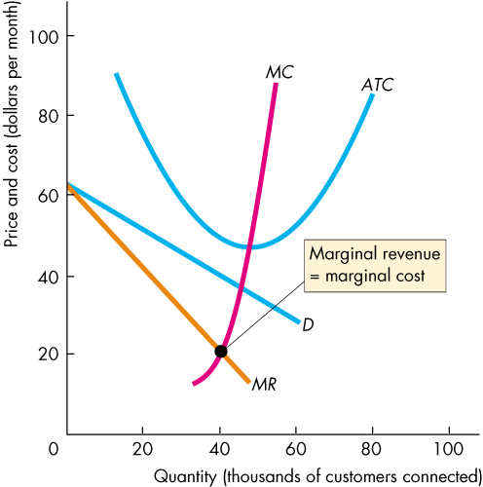
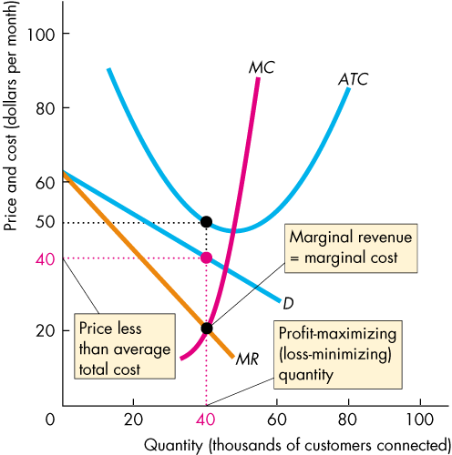
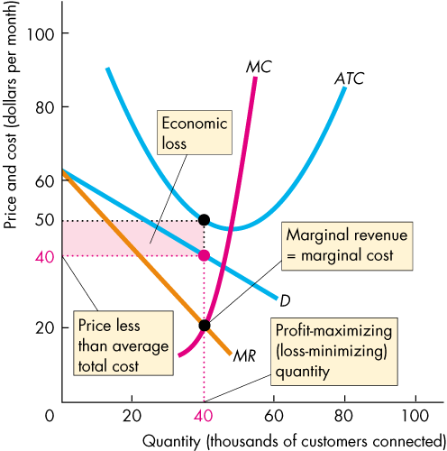
Price and Output in Monopolistic Competition
Profit Maximizing Might Be Loss Minimizing
  A firm might incur an economic loss in the short run.
  Here is an example.
  At the profit-maximizing quantity, P < ATC and the firm incurs an economic loss.

Slide 13
Price and Output in Monopolistic Competition
Long Run: Zero Economic Profit
  In the long run, economic profit induces entry.
  And entry continues as long as firms in the industry earn an economic profit—as long as (P > ATC).
  In the long run, a firm in monopolistic competition maximizes its profit by producing the quantity at which its marginal revenue equals its marginal cost, MR = MC.

Slide 14
Price and Output in Monopolistic Competition
  As firms enter the industry, each existing firm loses some of its market share. The demand for its product decreases and the demand curve for its product shifts leftward.
  The decrease in demand decreases the quantity at which MR = MC and lowers the maximum price that the firm can charge to sell this quantity.
  Price and quantity fall with firm entry until P = ATC and firms earn zero economic profit.

Slide 15
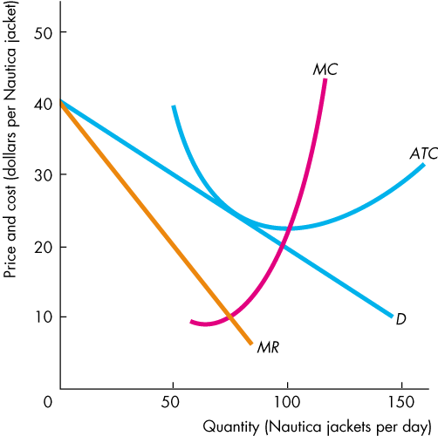
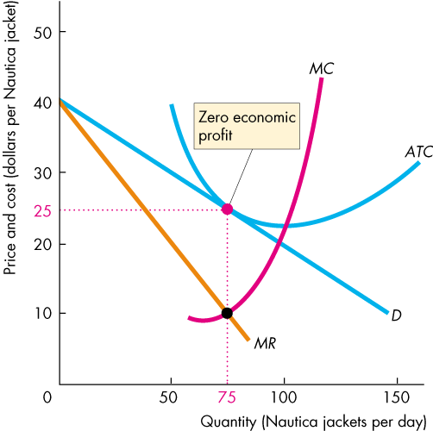
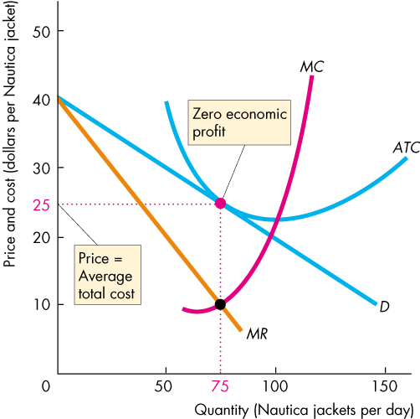
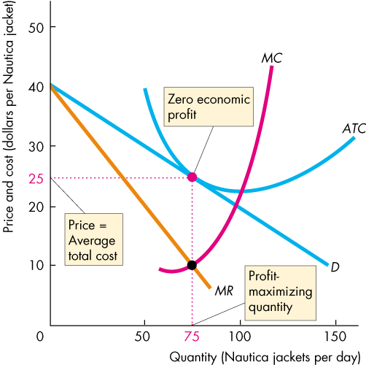
Price and Output in Monopolistic Competition
  The figure shows a firm in monopolistic competition in long-run equilibrium.

Slide 16
Price and Output in Monopolistic Competition
Monopolistic Competition and Perfect Competition
  Two key differences between monopolistic competition and perfect competition are:
  Excess capacity
  Markup
  A firm has excess capacity if it produces less than the quantity at which ATC is a minimum.
  A firm’s markup is the amount by which its price exceeds its marginal cost.

Slide 17
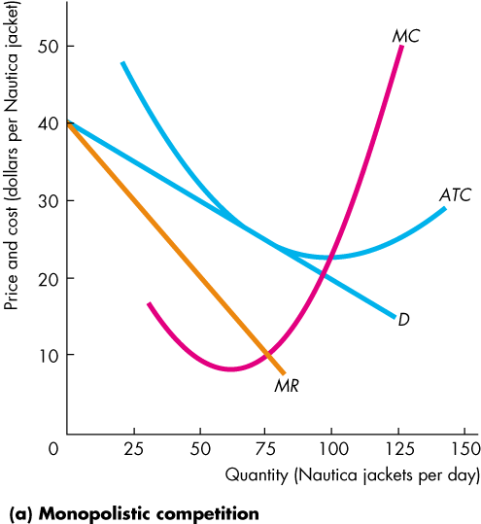
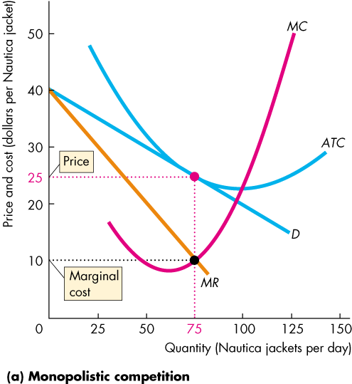
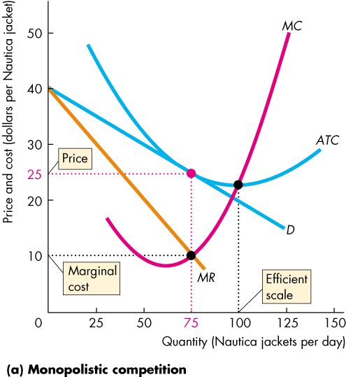
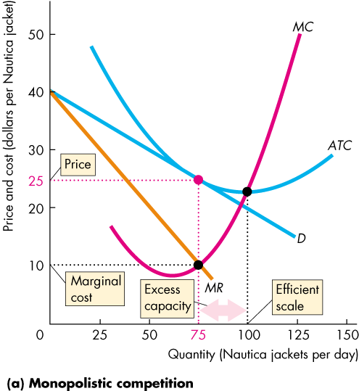
Price and Output in Monopolistic Competition
  Firms in monopolistic competition operate with excess capacity in long-run equilibrium.
  Firms produce less than the efficient scale—the quantity at which ATC is a minimum.
  The downward-sloping demand curve for their products drives this result.

Slide 18
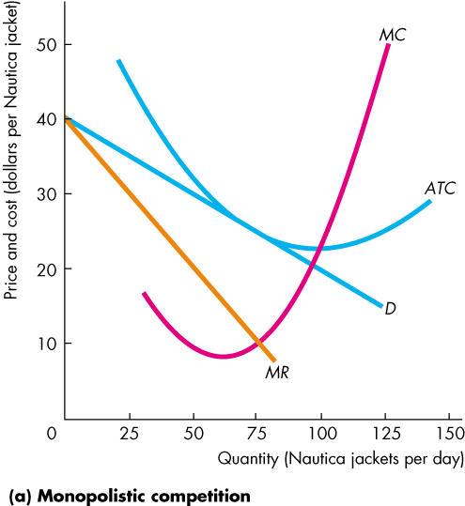
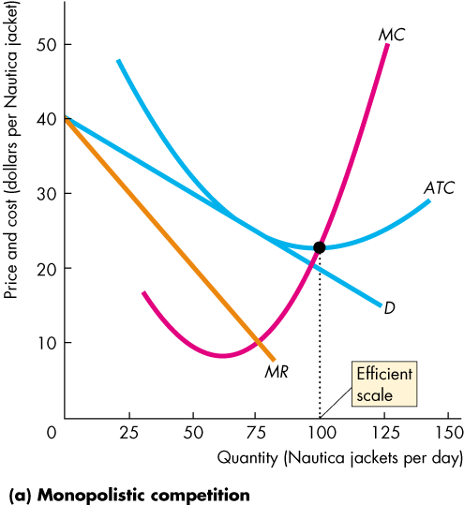
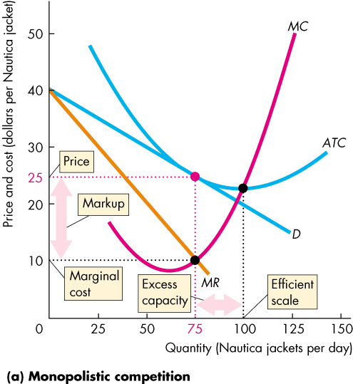
Price and Output in Monopolistic Competition
  Firms in monopolistic competition operate with positive markup.
  Again, the downward-sloping demand curve for their products drives this result.

Slide 19
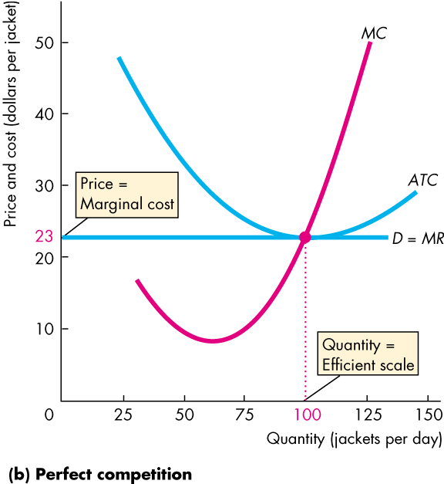
Price and Output in Monopolistic Competition
  In contrast, firms in perfect competition have:
  no excess capacity and no markup.
  The perfectly elastic demand curve for their products drives this result.

Slide 20
Price and Output in Monopolistic Competition
Is Monopolistic Competition Efficient?
  Price equals marginal social benefit.
  The firm’s marginal cost equals marginal social cost.
  Price exceeds marginal cost, so marginal social benefit exceeds marginal social cost.
  So the firm in monopolistic competition in the long run produces less than the efficient quantity.

Slide 21
Price and Output in Monopolistic Competition
  Making the Relevant Comparison
  The markup that drives a gap between price and marginal cost arises from product differentiation.
  But people value product variety, so the loss that arises because the quantity produced is less than the efficient quantity is offset by the gain that arises from having a greater degree of product variety.

Slide 22
Product Development and Marketing
Innovation and Product Development
  We’ve looked at a firm’s profit-maximizing output decision in the short run and in the long run, for a given product and with given marketing effort.
  To keep making an economic profit, a firm in monopolistic competition must be in a state of continuous product development.
  New product development allows a firm to gain a competitive edge, if only temporarily, before competitors imitate the innovation.

Slide 23
Product Development and Marketing
Advertising
  A firm with a differentiated product needs to ensure that customers know that its product differs from its competitors.
  Firms use advertising and packaging to achieve this goal.
  A large proportion of the price we pay for a good covers the cost of selling it.
  Advertising expenditures affect the firm’s profit in two ways:
  They increase costs, and they change demand.

Slide 24
Product Development and Marketing
  Selling Costs and Total Costs
  Selling costs, like advertising expenditures, fancy retail buildings, etc. are fixed costs.
  Average fixed costs decrease as production increases, so selling costs increase average total costs at any given quantity but do not affect the marginal cost of production.
  Selling efforts such as advertising are successful if they increase the demand for the firm’s product.

Slide 25
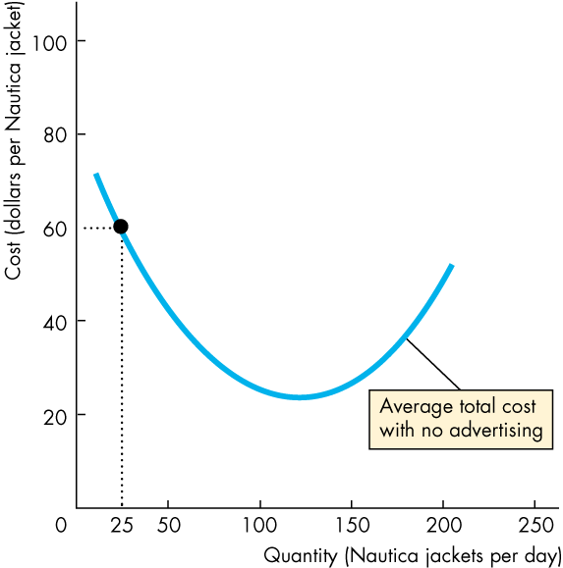
Product Development and Marketing
  Advertising costs might lower the average total cost by increasing equilibrium output and spreading their fixed costs over the larger quantity produced.
  Here, with no advertising, the firm produces 25 units of output at an average total cost of $60.

Slide 26
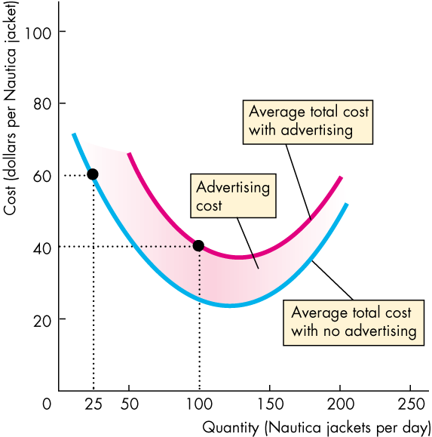
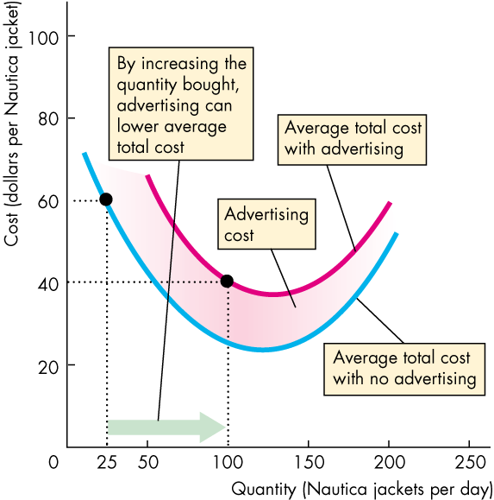
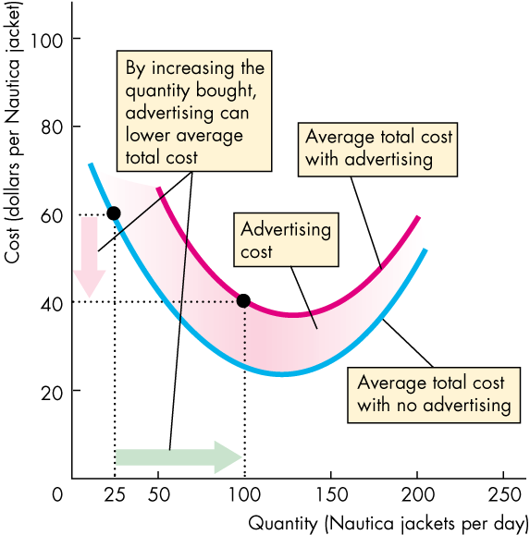
Product Development and Marketing
  With advertising, the firm produces 100 units of output at an average total cost of $40.
  Advertising expenditure shifts the ATC curve upward, but
  the firm operates at a larger output and lower average total cost than it would without advertising.

